Slide 1
FLIGHT PRICE PREDICTION
WEB SCRAPPING /REGRESSION
PROJECT PRESENTATION
PRESENTATED BY:-
(DINESH SHARMA)

Slide 2
GOAL

Slide 3
Goal
Forecast flight prices
Selecting optimum time for travel
Selecting the cheapest flight to the desired destination

Slide 4
SCRAPING

Slide 5
Scraping
Source & Destination
Date (Feb to April, 2022)
Price
Duration
Total Stops
Airline

Slide 6
Scraping Tool

Slide 7
Scraped Routes
SVO
NYC
PAR
RUH

Slide 8
Problems
Closing and opening the driver every 10 days (pages).
Alert the user to go solve the captcha and resume scraping.

Slide 9
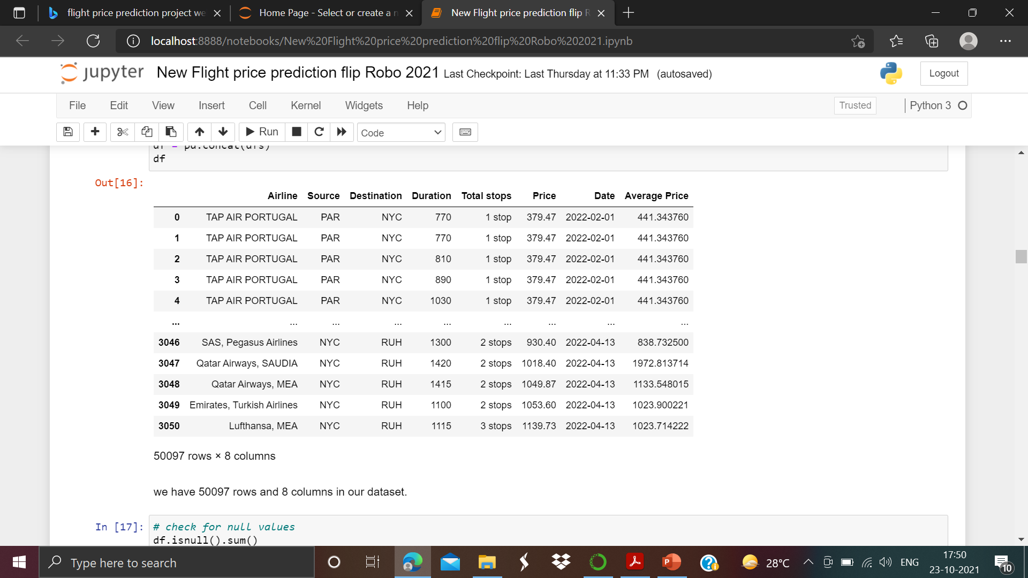
Scraped Dataset

Slide 10
EDA

Slide 13
FEATURES
Source (4)
Destination (4)
Total Stops
Average Price per Airline
Duration
Price

Slide 14
Results and Experiments

Slide 15
Results
Model / Metric Train (60%) Val (20%) MAE MSE RMSE
Linear Regression 0.804 0.789 225.09 152995.68 391.15
Polynomial (5) 0.888 0.871 149.72 93366.04 305.56
Lasso 0.803 0.789 223.49 153097.06 391.28
Ridge 0.804 0.789 225.08 152995.61 391.15
Elastic Net 0.790 0.775 224.41 163034.63 403.78
Random Forest 0.965 0.945 61.72 40035.32 200.09

Slide 16
Other Experiments
Feature Importance
Feature Scaling
Hyperparameter Tuning
Randomized Search CV

Slide 17
Result
Retraining the random forest model on train + val and scoring on test.
Before and after hyperparameter tuning using random search CV:
Metric MAE MSE RMSE
Before 61.87 40409.87 201.02
After 64.19 41409.93 203.49

Slide 18
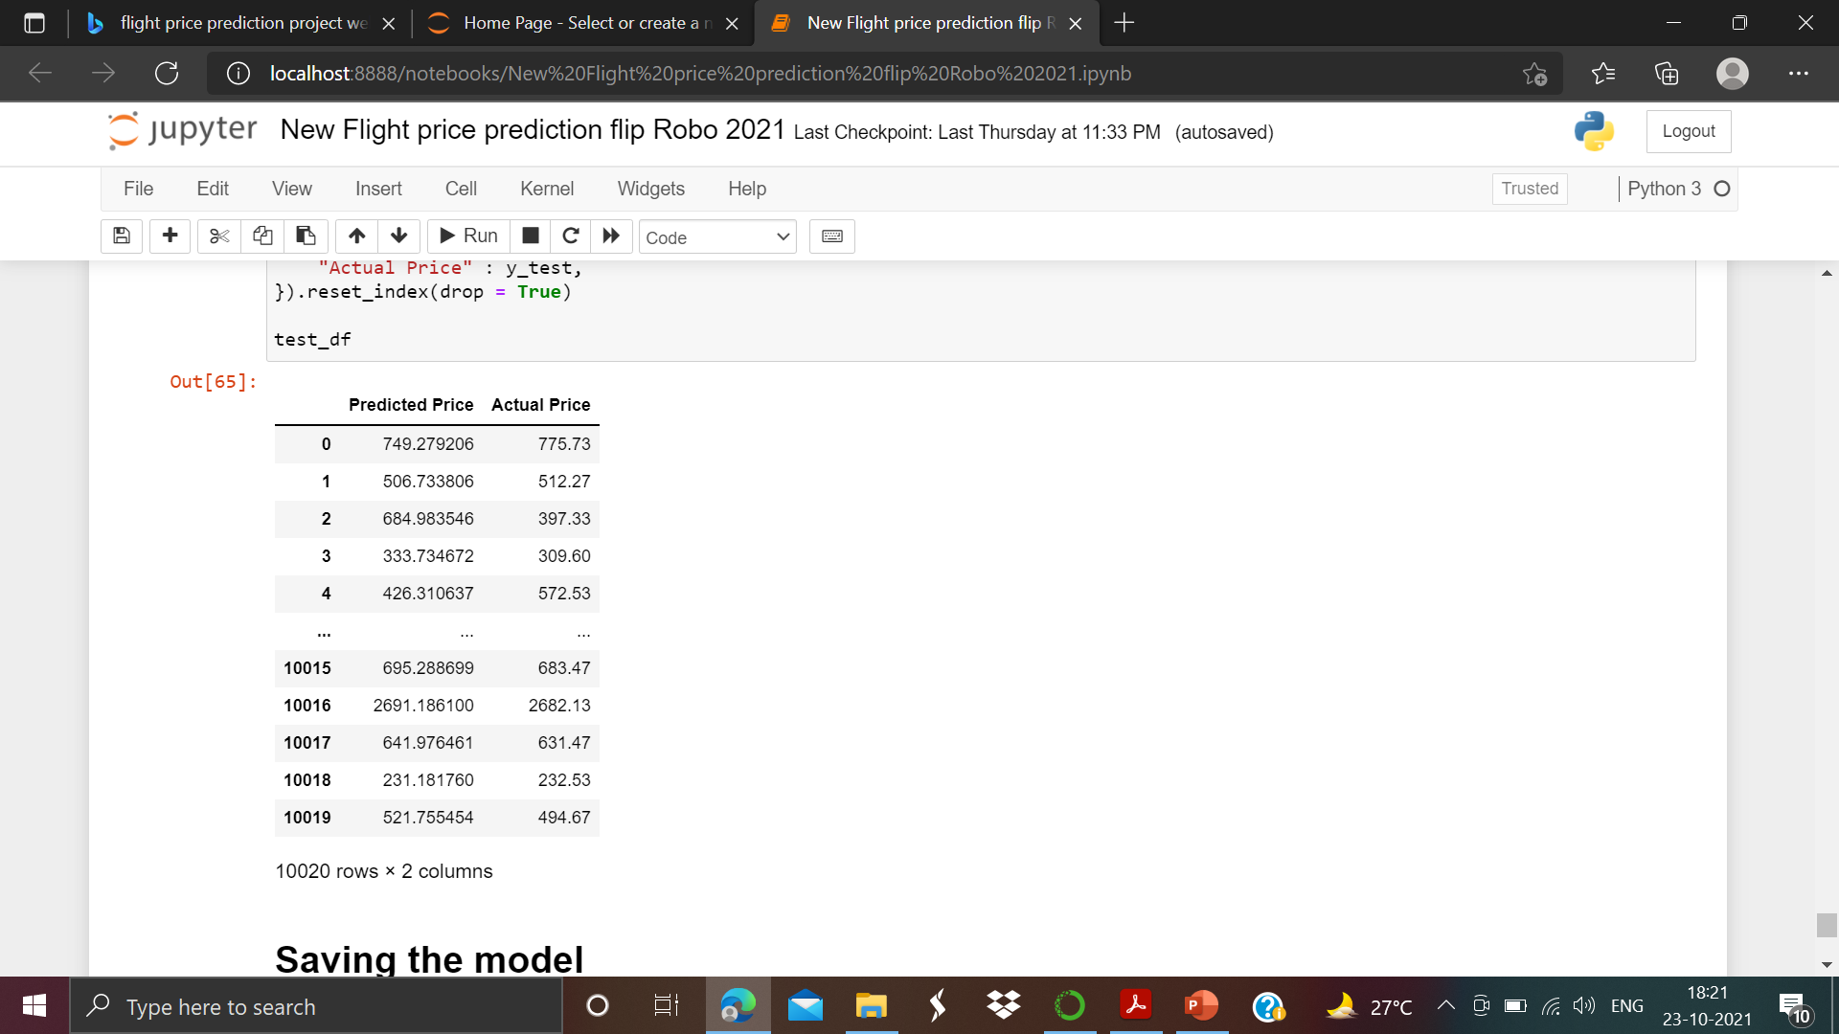
Result
$61.87

Slide 19
Recommendations

Slide 20
Recommendations
Consider the date as a feature
Consider autocorrelation
More sources / destinations
Increase the period (dates)

Slide 21
THANKS

